Slide 1
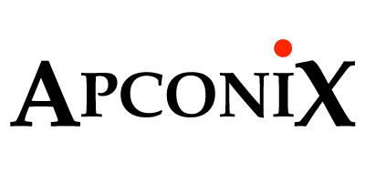


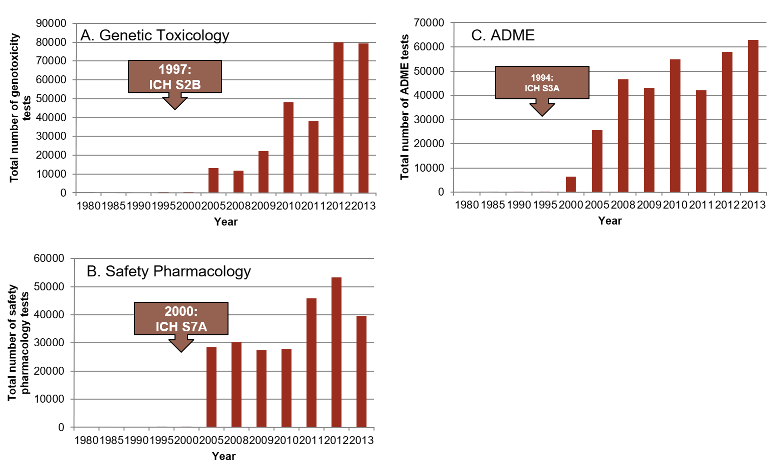
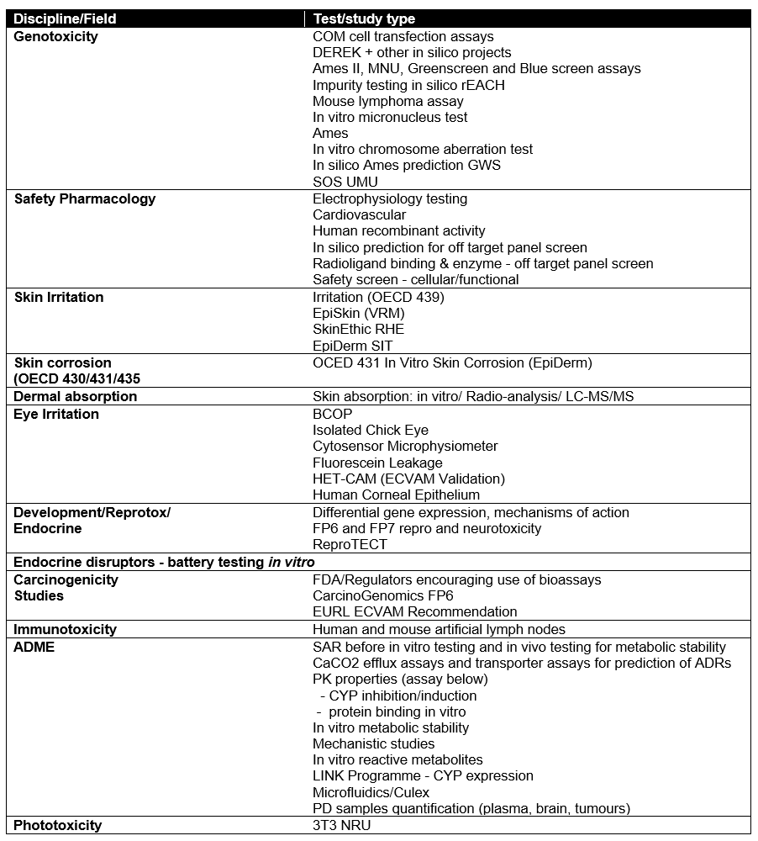
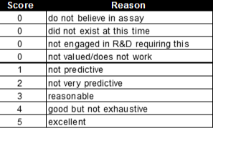

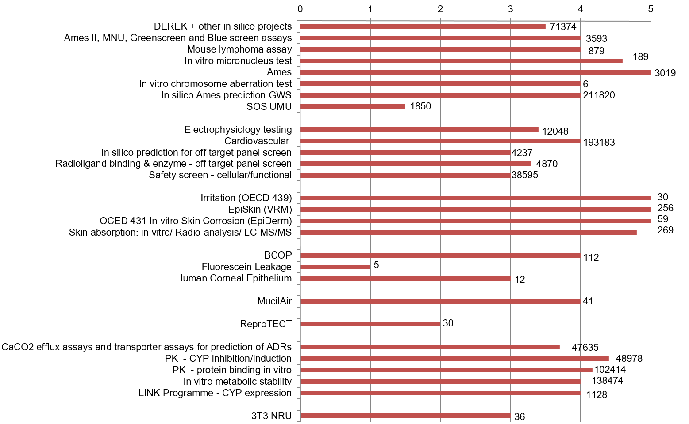
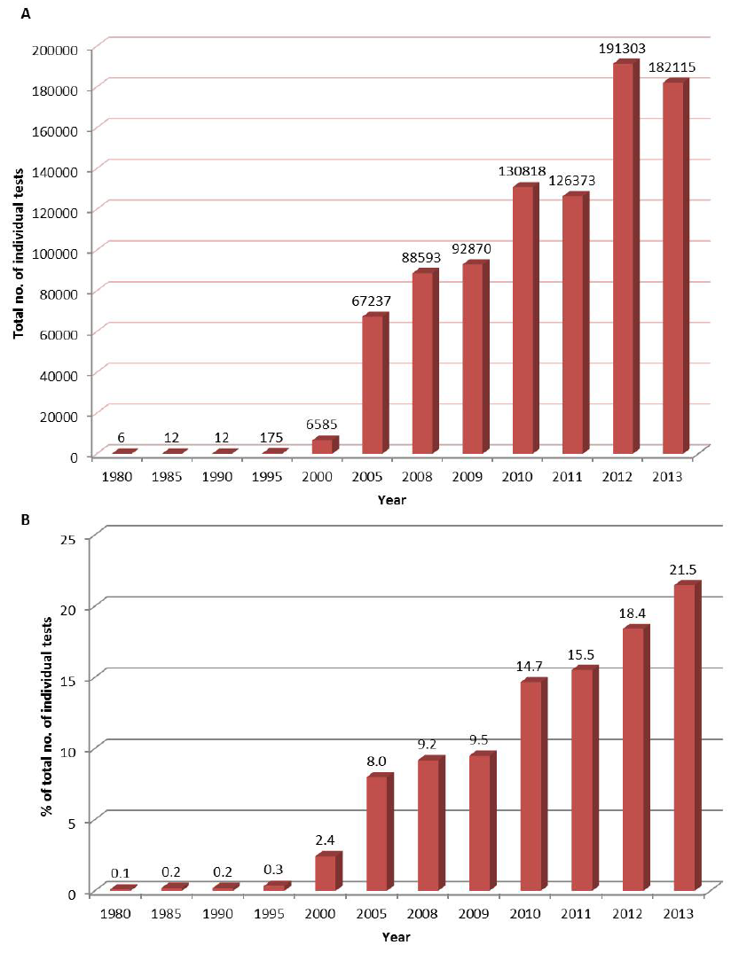
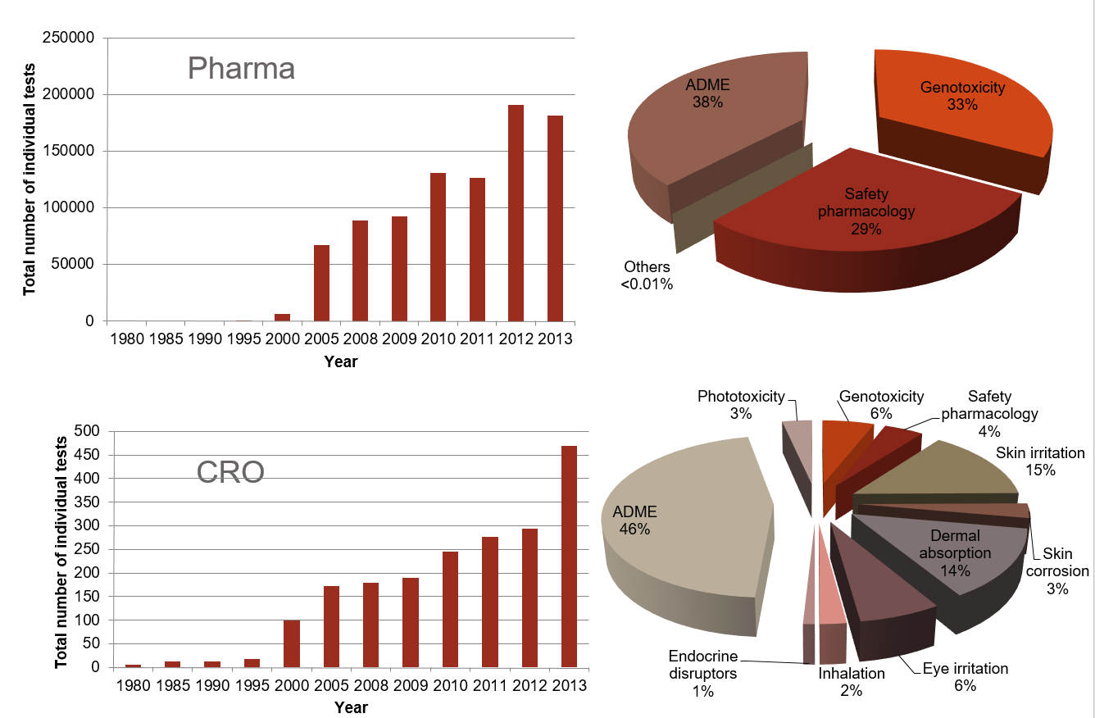
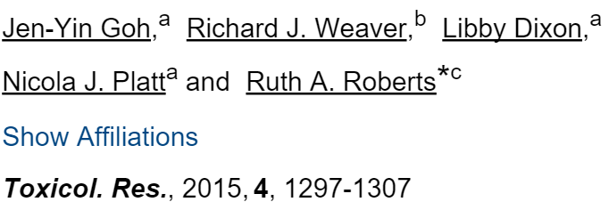
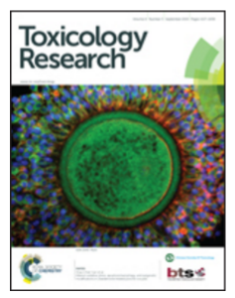
Development and Use of In Vitro alternatives to Animal Testing by the Pharmaceutical Industry 1980-2013
J-Y Goh, R J Weaver, L Dixon, N J Platt and R A Roberts
ª: ABPI, London ^{b}: International Research Institute Servier (IRIS), France; ^{c} ApconiX, BioHub at Alderley Park
Integrated Toxicology and Ion Channel Expertise
Aim
Support the development and use of in vitro (including in silico) alternatives by examining their use in preclinical safety testing by the pharmaceutical industry between 1980 and 2013 to determine patterns, drivers and challenges in uptake
Fig 3. Number of reported assays in the 3 main categories
Approach
Survey sent to the ABPI member companies requesting the number of compounds screened using in vitro and in silico tests at 5-year intervals between 1980 and 2005 then yearly from 2008 onwards.
Table1. Fields and tests listed in the survey spreadsheet.
Step changes in assay use reflect adaptation of relevant ICH guideline
Table2. Utility scores of 0 to 5 with explanation were requested as feedback from respondents on the utility of each in vitro test and were used to assist in interpretation of historical trends in the use of the in vitro assays.
Fig 4. Utility scores for the different assays (see Table 1). Numbers on the bars are the n for each assay.
Fig 1 Total of all assays as raw (A) or normalised (B) data Fig 2 Pharma or CRO showing test breakdown
Large variability in perception of utility (see Table 1): this likely had a big impact on uptake
>900 000 data points returned; >70% since 2010
4 Pharma & 3 CRO
Similar patterns in CRO and Pharma
Different assays predominate: genetic tox, ADME and Safety Pharmacology dominate pharma
CRO more diverse
Conclusion
Collaboration between industry, government and academia has driven a large increase in uptake and use of in vitro alternatives to animal testing.
In considering further replacement, much can be learned from what was successful in the past and more importantly what was not

